Slide 1


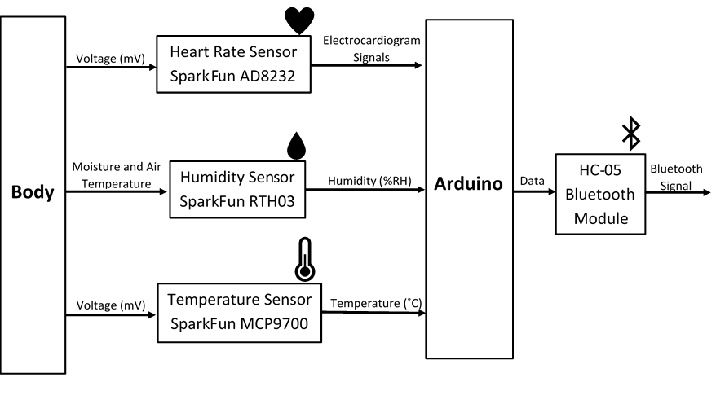




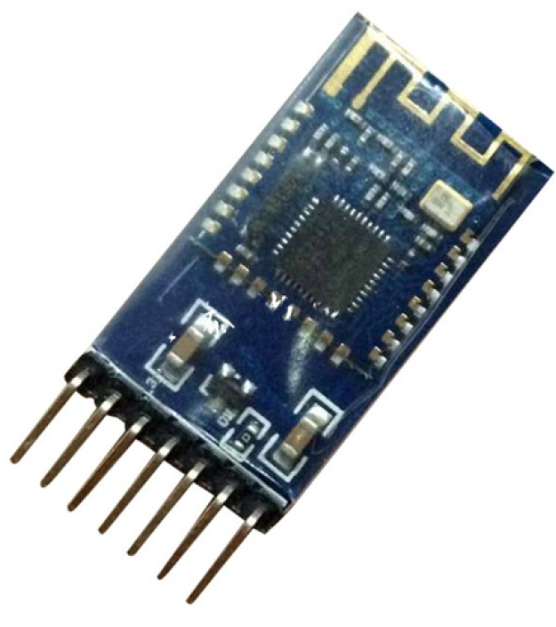
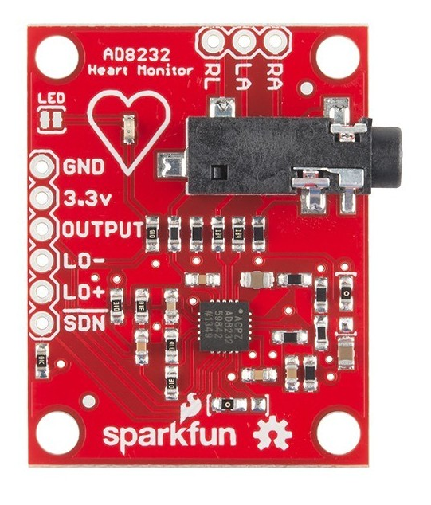
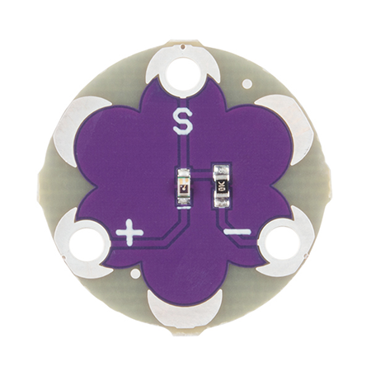
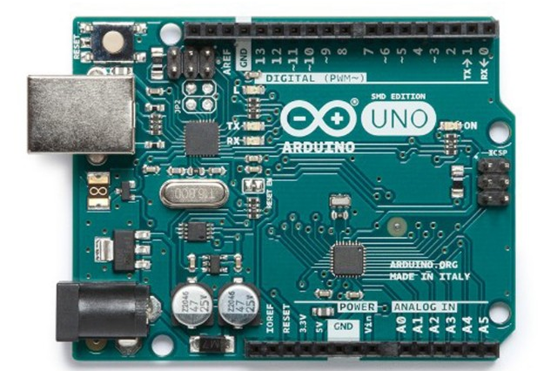
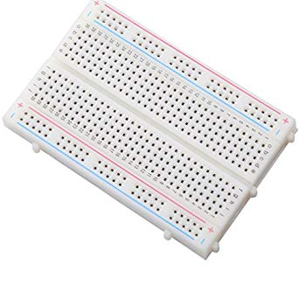

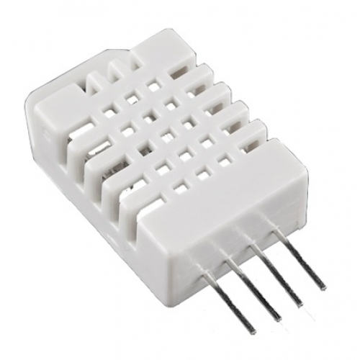

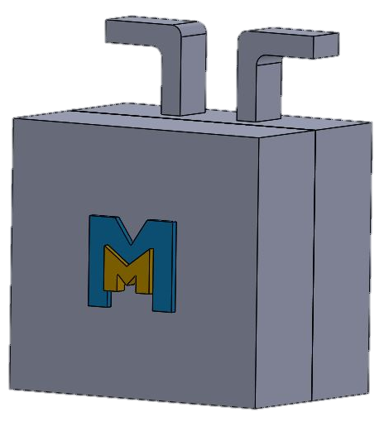
Superficial Surgical Incision Site Infection Monitor
Maya Davidovic, Kate Josiak, Brandon Koolhaas, Dan Slezak
Bio-Instrumentation Design - School of Engineering
OBJECTIVE AND MOTIVATION
DESIGN OVERVIEW
Surgical site infections (SSIs) cause 77% of deaths among surgery patients, and increase hospital stay by an average of 11 days [1]
In Canada, SSIs occur in 2-5% of all surgeries; these result in 60% more time in the intensive care unit [1]
84% of SSIs occur after hospital discharge [2]
Design a device which detects the symptoms of an oncoming infection in a superficial surgical wound by monitoring heart rate, body temperature and wound humidity
Have the user notified via smartphone app if symptoms are seen
APP OUTPUT
Increase of percent relative humidity greater than 75% indicates saturation of wound wrapping [4]
The sensors interface with the HC-05 Bluetooth module and the data is sent to the app on a smartphone device
If the measured values surpass the threshold, the app notifies the user via smartphone push notification
The app was created with MIT App Inventor
The temperature sensor is a thermistor used for measuring skin temperature
Increase of ~1.5 ˚C -2.2 ˚C indicates inflammation [3]
Increase of ~3 ˚C or more indicates infection [3]
Heart rate increases 8.5 beats per minute (bpm) per 1˚C increase in body temperature [5]
Increase of ~17 bpm indicates inflammation [5]
Increase of ~25 bpm indicates infection [5]
FUTURE DEVELOPMENT
The app will interface with the patient’s medical records in order to keep the patient’s physician updated with the status of the incision site
A pH ISFET sensor would be added to monitor the wound pH since increased alkalinity indicates infection
Create a more compact device and user friendly app
MARKET ANALYSIS
CONCLUSIONS
All competitors creating a hardware monitoring device
are in the developmental stage
The MediMonitor stands out in the market due to its real-time monitoring and communication with the patient’s smartphone
Healthcare spending in Canada is projected to increase from 2.7% in 2016 to 7.5% in 2020 [6]
Hospitals and public health institutions are our target market, spending C$41.5 billion annually [6]
Raw Material Cost of $252.49; Bulk Material Cost of $202.67
Selling for $699.99/device with a bulk discount of $4999.99 for 10 devices
A superficial surgical incision site monitor was designed using three sensors and interfaced to an app on the patient’s smartphone
Sensors used include a heart rate sensor, temperature sensor, and humidity sensor which monitored the symptoms of an infection
Using this device will help to prevent severe surgical site infections as well as decrease healthcare industry costs
REFERENCES
[1] Canadian Patient Safety Institute. Canadian Surgical Site Infection Prevention Audit Month: February 2016. (2016), http://www.patientsafetyinstitute.ca/en/toolsResources/Documents/SSI%20Audit%202016_Recap%20Report%20EN.pdf. Accessed 9 Oct. 2018
[2] K. Sands, G. Vineyard, R. Platt, “Surgical site infections occurring after hospital discharge”, J Infect Dis., vol.174, no. 4 , p. 963-970, April 1996. [Abstract]. Available: https://www.ncbi.nlm.nih.gov/pubmed/8603978. [Accessed Nov. 12, 2018].
[3] Del Bene V.E. Clinical Methods: The History, Physical and Laboratory Examinations. Butterworth Publishers, 1990, p.Ch.12. https://www.ncbi.nlm.nih.gov/books/NBK331/
[4] advancedtissue.com, ‘Understanding the Ins and Outs of Wound Drainage’, 2016. [online]. Available: https://advancedtissue.com/2016/02/understanding-the-ins-and-outs-of-wound-drainage/ . [Accessed: 23-Oct-2018]
[5] Karjalainen, Jouko., Viitasalo, Matti. “Fever and Cardiac Rhythm.” Arch Intern Med, vol. 146, no.6, June 1986, DOI: 10.1001/archinte.1986.00360180179026. Accessed 10 Oct. 2018
[6] “Canada - Healthcare and Medical EquipmentCanada - Medical Equipment,” Korea - Distribution and Sales Channels. [Online]. Available: http://www.export.gov/article?id=Canada-Healthcare-andMedical-Equipment. [Accessed: 12-Nov-2018].

